Slide 1

VOCABULARY GAME ‘Cows and Bulls’

Slide 2
Team Members
Madan Kapoor-113214104062
Manit Kapoor -113214104069
Guide : Mrs GunaSundari

Slide 3
ABSTRACT
The Objective of this mini project to build a vocabulary skill and word skill increasing
Game Named “Cows and Bulls” .Mind games fascinate a lot of people and It increases our Vocabulary
and logical skills .We have designed a word game in a interactive GUI desktop application .it is built using
the Gtk+ 3 toolkit in the C programming Language. The words are taken from Internet and their source is
referenced in the Application. We hope that the game users will enjoy the experience of the word game
‘Cows and Bulls’.

Slide 4
Outline
Existing Systems
Game Design
SnapShots

Slide 5
Existing Systems
The first official massively multiplayer (MMO) version of this game was first made available as WORD - Multiplayer Word Game which requires two players.
Few versions of this type game are available in web severs which requires a internet connection and it is interrupted by many ads.
There is no version found for Windows Environment.

Slide 6
Game Design
The Game is designed using a Signal and event system designer.
The frontend consists of Gtk+ widgets styled using Css3.
The Game’s Backend is in C language with Physical Data Model

Slide 7
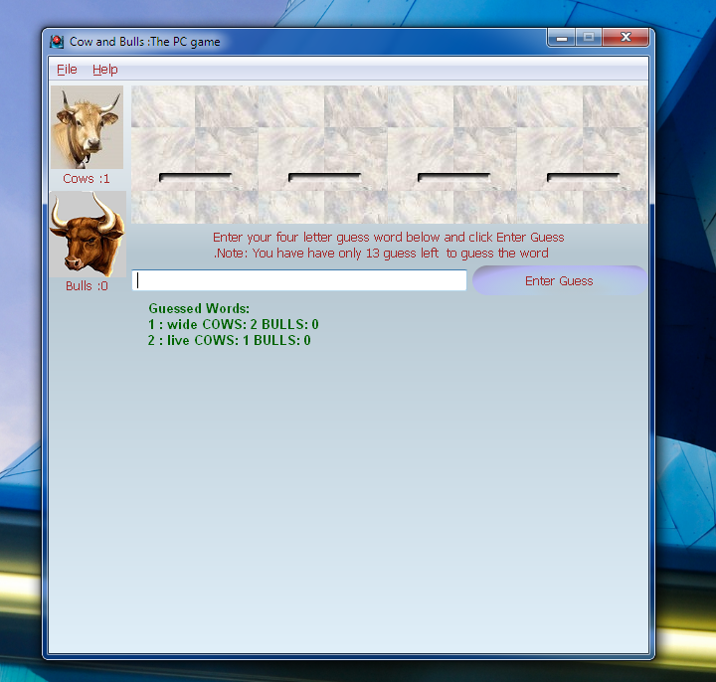
SnapShot1

Slide 8
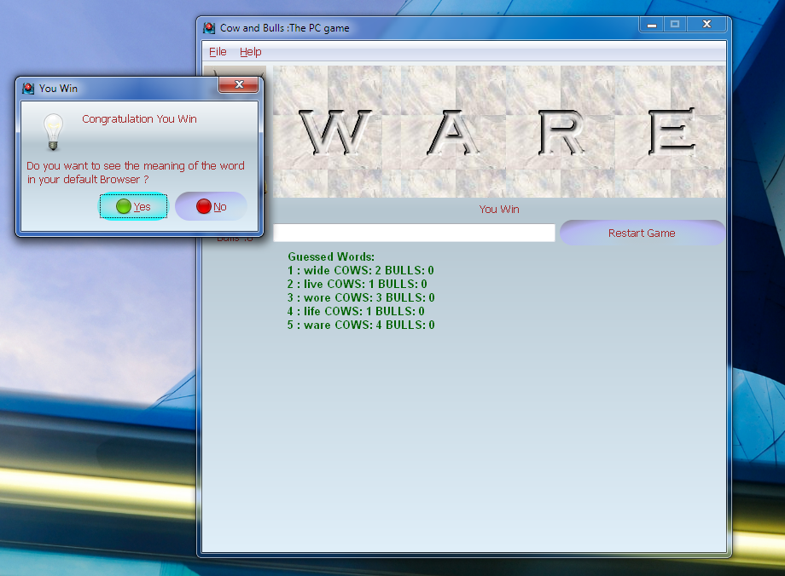
SnapShot2

